Slide 1
5140602 FUNDAMENTAL DEMOGRAPHIC ANALYSIS · SESSION 3
Population Composition:
Age–Sex Structure and the Demographic Dividend
Population pyramids · sex ratios · dependency ratios · the demographic-dividend framework
College of Population Studies, Chulalongkorn University
Asst. Prof. Dr. Ruttiya Bhula-or
3-hour session · Revised 2026 syllabus · 60-slide expanded edition
Session 3 · Age–Sex Structure & the Demographic Dividend
1 / 60

Slide 2
SESSION OVERVIEW
Learning Objectives
1
Construct & read
2
Measure imbalance
Build and interpret population pyramids, identifying expansive, constrictive, and stationary shapes — and avoid the common misreadings of each.
Calculate and interpret the sex ratio and sex ratio at birth (SRB), including the global "missing women" phenomenon, with two fully worked numeric examples.
3
Compute dependency
4
Apply the dividend model
Calculate youth, old-age, and total age-dependency ratios and the aging index from real age-group data for two different countries.
Explain the first and second demographic dividend framework (Mason & Kinugasa, 2008), work through a growth-contribution calculation, and apply it to Thailand's trajectory.
Session 3 · Age–Sex Structure & the Demographic Dividend
2 / 60

Slide 3
TODAY'S PLAN
Agenda — 180-Minute Session Structure
1
Welcome & learning objectives
2
Block 1 — Age-sex pyramids, sex ratio & the "missing women" problem
3
Block 2 — Age-dependency ratios (worked numeric examples, two countries)
☕
BREAK
4
Block 3 — The demographic-dividend framework & Thailand / East Asia case studies
5
In-class discussion & practice exercises
6
Summary & references
Session 3 · Age–Sex Structure & the Demographic Dividend
3 / 60

Slide 4
01
Age–Sex Structure: Pyramids and Sex Ratios
How a population's age and sex composition is measured, visualized, and interpreted — and what a distorted sex ratio at birth reveals about a society.
Session 3 · Age–Sex Structure & the Demographic Dividend
4 / 60

Slide 5
FOUNDATIONS
What Is Population Composition?
The distribution of a population across age groups and sex at a point in time — a structural "snapshot" produced by the joint history of fertility, mortality, and migration.
Age–sex structure determines current and future demand for schools, jobs, health services, and pensions — it is the demographic skeleton beneath every economic and social plan.
Standard building block: 5-year age groups (0–4, 5–9, …, 80–84, 85+) cross-tabulated by sex, usually drawn from a census, register, or household survey.
Visualized using a population pyramid — two back-to-back horizontal bar charts, males on the left, females on the right, youngest cohort at the base.
⛛
5-yr
Standard age-group width used worldwide for pyramid construction
Session 3 · Age–Sex Structure & the Demographic Dividend
5 / 60

Slide 6
TYPOLOGY
Three Canonical Pyramid Shapes
Expansive
Constrictive
Stationary
Wide base, rapid taper
Narrow base, bulging middle
Near-rectangular
High fertility, high (falling) mortality. Broad youth cohorts. Typical of pre-transition / early-transition countries.
Sustained sub-replacement fertility with rising longevity. Base narrower than working-age bulge; top is widening.
Low, stable fertility and mortality over a long period; roughly equal cohort sizes until old age.
Long-run pattern approached by some Northern/Western European populations (UN WPP, 2024)
e.g., Niger — TFR ≈ 6–7, ~70% of population under 25 (UN/Worldometer, 2024)
Thailand, 2025 — median age 41.5 years, a "complete-aged society" (NSO, 2025)
Some Policy priorities
Expand voluntary family planning and maternal healthcare.
Invest in nutrition, education, and child survival.
Create skills pathways and sufficient decent employment.
Prepare to capture the demographic dividend.
Some Policy priorities
Provide affordable childcare and family-friendly employment.
Extend healthy working lives and lifelong learning.
Strengthen pensions, healthcare, and long-term care.
Use productivity improvements and well-managed migration.
Some Policy priorities
Maintain balanced services across all age groups.
Invest in productivity, skills, and preventive healthcare.
Monitor migration and regional population imbalances.
Adapt infrastructure gradually to emerging demographic changes.
Session 3 · Age–Sex Structure & the Demographic Dividend
10 / 60

Slide 7
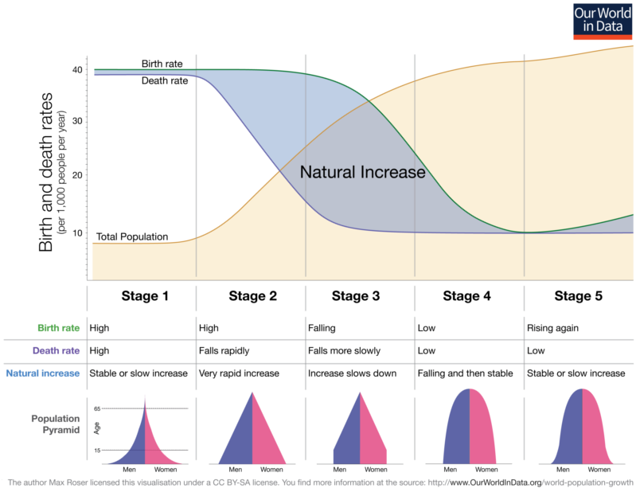
The Changing World Population Pyramid
Source: Desjardins, J. (2019, May 7). Longer lifespans are changing the shape of the world’s population pyramid. World Economic Forum. https://www.weforum.org/stories/education-and-skills/the-world-population-pyramid-1950-2100/

Slide 8
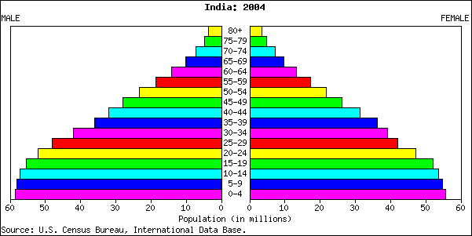
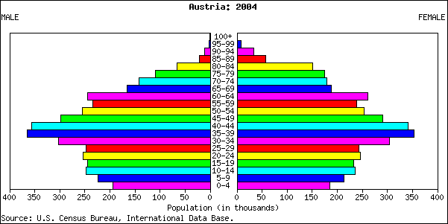
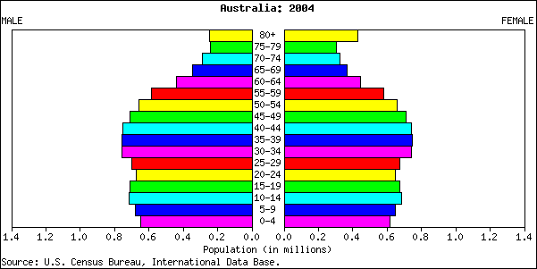
Observe the different transition

Slide 9
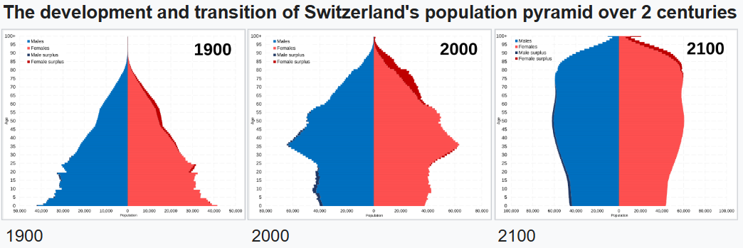
Observe the transition
Session 3 · Age–Sex Structure & the Demographic Dividend
10 / 60

Slide 10
METHOD · STEP 1 OF 3
Constructing a Pyramid — Data Preparation
1
Group the population into 5-year age bands, by sex
Start from individual-level records (census or survey microdata) or an age-by-sex tabulation already published by the national statistics office.
Assign every person to one 5-year band: 0–4, 5–9, 10–14, … 80–84, 85+ (open-ended top band).
Keep males and females in separate columns from the start — do not pre-sum them, since the pyramid needs each cell (age × sex) as a distinct count.
Check totals reconcile: sum of all age-sex cells = the population total reported elsewhere for the same reference date.
Minimal data layout
Age band | Male | Female
0–4 | 2,410,300 | 2,301,900
5–9 | 2,180,700 | 2,079,400
… | … | …
80–84 | 231,900 | 312,400
85+ | 168,200 | 276,500
Session 3 · Age–Sex Structure & the Demographic Dividend
6 / 60

Slide 11
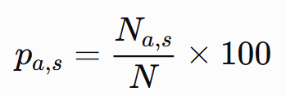
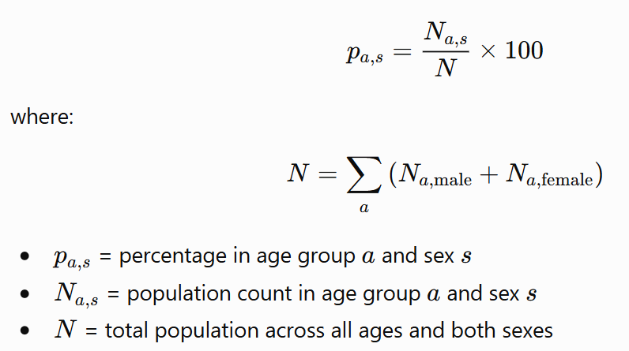
METHOD · STEP 2 OF 3
Constructing a Pyramid — Convert to Percentages
2
Convert each age–sex group into a percentage of the total population:
Divide by the total population (males + females) — never by the sex-specific subtotal (all males, or all females) — so that bars are comparable across countries of different size and across the male/female sides of the same pyramid.
Using the sex-specific total instead is the single most common student error: it forces both sides of the pyramid to sum to 100% independently, which conceals any true sex imbalance in the population and breaks left–right comparability.
Rule of thumb: every one of the 2 × 18 age-sex bars in a full pyramid should sum to 100% in total, not 100% on each side.
Session 3 · Age–Sex Structure & the Demographic Dividend
7 / 60

Slide 12
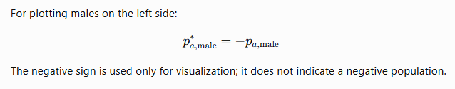
METHOD · STEP 3 OF 3
Constructing a Pyramid — Plotting Convention
3
Plot as opposed horizontal bars from a shared central axis
males
females
Males extend left, females extend right, from a shared vertical axis in the center.
Youngest cohort (0–4) forms the base; oldest (85+) forms the apex — age increases upward.
Bar length = % of total population in that age-sex band (from Step 2), not the raw count.
Use a consistent age-band height and axis scale across any pyramids you plan to compare side-by-side.
Session 3 · Age–Sex Structure & the Demographic Dividend
8 / 60

Slide 13
METHOD · QUALITY CHECK
Common Pyramid-Construction Errors
✕
Wrong denominator
✕
Inconsistent age-band width
Dividing by the sex-specific subtotal instead of the grand total — breaks left/right comparability (see Step 2).
Mixing 5-year bands with a wider open top band without labeling it, or comparing a 5-year-band pyramid to a 10-year-band one.
✕
Ignoring the reference date
✕
Uncorrected age heaping
Combining age data from a census year with population totals from a different year — cells then no longer sum correctly.
Plotting single-year ages instead of 5-year groups when heaping is present — produces a jagged, misleading profile (see next slide).
Session 3 · Age–Sex Structure & the Demographic Dividend
9 / 60

Slide 14
HOW TO READ THIS CORRECTLY
Pyramid Misconceptions — and How to Avoid Them
✕
"A pyramid is a snapshot of the future."
It is a snapshot of the present age structure. Future shape depends on future fertility, mortality, and migration — a pyramid does not forecast itself without a projection model.
✕
"A bulge always means a baby boom."
A bulge can also come from in-migration of working-age adults, or from a past mortality shock that thinned a specific cohort elsewhere — always check the surrounding bands and context.
✕
"Symmetry between male and female sides is normal at every age."
Near-symmetry is expected only in youth. Male mortality is higher at nearly every adult age, so a healthy pyramid becomes female-skewed at the top — asymmetry there is not necessarily meaningful.
✕
"Two countries with the same total dependency ratio have the same policy problem."
Composition matters as much as the total — a youth-driven and an elderly-driven dependency load require very different policies (see Block 2).
Session 3 · Age–Sex Structure & the Demographic Dividend
11 / 60

Slide 15
METHODOLOGY
Where Age–Sex Data Come From — and Their Limits
Census
CRVS
Surveys
Full enumeration, typically every 5, 10 years (Eg Thailand: 2020, 2025). Gold standard for age-sex structure but expensive and infrequent.
Continuous recording of births/deaths via civil registration & vital statistics; feeds annual population estimates between censuses.
e.g., Thailand's Survey of Population Change, Labour Force Survey — smaller samples, more frequent, subject to sampling error.
Common data-quality problem — age heaping
Respondents round reported ages to preferred digits (0, 5), distorting single-year age distributions. Demographers work with 5-year age groups specifically to average out this noise (full detection method on the next slide).
Session 3 · Age–Sex Structure & the Demographic Dividend
12 / 60

Slide 16
A THIRD FORCE
Migration Also Reshapes Age–Sex Structure
A population pyramid normally represents all usual residents—nationals and migrants—unless the source specifies a different population definition.
Fertility and mortality are not the only forces behind a pyramid's shape — net migration can visibly notch or bulge specific age-sex bands.
Labor migration is typically age- and sex-selective: young working-age adults move for jobs, thinning the sending country's pyramid at those ages and thickening the receiving country's.
Thailand is simultaneously a sending and a major receiving country in the Mekong subregion — migrant workers from Myanmar, Cambodia, and Lao PDR partly offset the shrinkage of Thailand's own working-age cohort.
Implication: any dependency-ratio or dividend calculation using only births and deaths will misstate the true working-age support base wherever migration is substantial — always check whether data are for the resident (de facto) or citizen (de jure) population.
Session 3 · Age–Sex Structure & the Demographic Dividend
14 / 60

Slide 17
Eight-Minute Activity: Compare Two Population Pyramids
Pairing exercise
Tool: https://www.populationpyramid.net/world/2026/
Choose two countries with contrasting population structures.
Five-minute task
Select two countries.
Compare their 2026 population pyramids.
Examine changes in 2000, 2026, and 2050.
Agree on major findings and policy implications.
For each country, identify:
overall pyramid form: expansive, stationary, constrictive, or irregular;
population base, working-age population, and older population;
major cohort bulges, gaps, or sex imbalances; and
child and old-age dependency patterns.
Analyse
What do the differences suggest about fertility, mortality, longevity, migration, and population momentum?
How did each country’s structure change between 2001 and 2026?
What further changes are projected for 2050?
What are two priority policy responses for each country?
Data note: PopulationPyramid.net uses the UN World Population Prospects 2024 Revision, medium variant. Figures for 2050 are projections based on assumptions about fertility, mortality, and migration.
Three-minute group presentation

Slide 18
MEASUREMENT
The Sex Ratio: Definition and Variants
SR = (Males ÷ Females) × 100
SRB = (Male births ÷ Female births) × 100
General sex ratio (SR)
Sex ratio at birth (SRB)
Interpreted as "males per 100 females." Can be computed for the total population or for any age group.
Biological baseline ≈ 104–106 boys per 100 girls, remarkably stable across populations absent intervention.
Why it matters: a population's overall sex ratio reflects sex differences at birth, sex-differential mortality across the life course, and net migration by sex. A sustained SRB above ~106 is strong evidence of sex-selective practices, not biology.
Source: UNFPA (2012). Sex Imbalances at Birth. unfpa.org/sites/default/files/pub-pdf/Sex Imbalances at Birth. PDF UNFPA APRO publication 2012.pdf
Session 3 · Age–Sex Structure & the Demographic Dividend
16 / 60

Slide 19
WORKED EXAMPLE · ILLUSTRATIVE DATA
Computing a Sex Ratio at Birth, Step by Step
Country A — one year of births
105.1
Interpretation
Male live births | 523,400
Female live births | 497,800
Total live births | 1,021,200
105.1 falls squarely within the biological baseline of 104–106 boys per 100 girls, so this hypothetical country shows no evidence of sex-selective practices in this year's births.
Step-by-step calculation
Step 1 — Identify inputs: Male births = 523,400; Female births = 497,800
Step 2 — Apply the formula: SRB = (523,400 ÷ 497,800) × 100
Step 3 — Compute the ratio: 523,400 ÷ 497,800 = 1.0514
Step 4 — Multiply by 100: SRB = 105.1 boys per 100 girls
Compare this to Example 2 ("missing women," next block) where sustained SRBs of 111–121 signal a very different pattern.
Session 3 · Age–Sex Structure & the Demographic Dividend
17 / 60

Slide 20
WORKED EXAMPLE 2 · REAL DATA, 2023–2024
A Second SRB Example: Vietnam's Persistent Imbalance
Vietnam's General Statistics Office (GSO) reported an SRB of 112 boys per 100 girls in 2023, easing slightly to 110.7 in 2024 — still well above the 104–106 biological baseline.
Government policy sets a national target of bringing the SRB below 109 by 2030 under Vietnam's population strategy.
112
boys per 100 girls, Vietnam 2023 (GSO)
Why this matters: an SRB this far above baseline, sustained over years, is one of the clearest quantitative fingerprints of sex-selective abortion linked to strong son preference — a pattern also seen historically in China and India (next slides).
Reconstructing the underlying counts
If female births in a region = 100,000, and SRB = 112:
Male births = SRB ÷ 100 × Female births = 1.12 × 100,000 = 112,000
Total births = 212,000 → of which 52.8% are boys, 47.2% girls.
Source: Vietnam General Statistics Office (GSO), reported in Xinhua (2024), "Vietnam's sex ratio at birth remains high," english.news.cn/20240105; national census on civil status (2024) reporting 110.7 for 2024.
Session 3 · Age–Sex Structure & the Demographic Dividend
18 / 60

Slide 21
BEYOND BIRTH
The Sex Ratio Changes Across the Life Course
Male excess at birth (~105) is progressively eroded by higher male mortality at every subsequent age — accidents and cardiovascular disease in mid-life, then general frailty differences at older ages.
By the oldest ages, women greatly outnumber men in most populations — with direct implications for widowhood, solo living, and elder-care demand.
This is why an overall sex ratio can look "balanced" even when the SRB is distorted — mortality only slowly erases an early imbalance.
Curve shape is a stylized composite typical of low-mortality populations, for teaching purposes; exact values vary by country and cohort.
Session 3 · Age–Sex Structure & the Demographic Dividend
19 / 60

Slide 22
HOW TO READ THIS CORRECTLY
Sex-Ratio Misconceptions — and How to Avoid Them
✕
"A national SR near 100 means no sex-selection problem."
A balanced overall SR can coexist with a distorted SRB — mortality differences across a whole lifespan can mask a birth-level imbalance (previous slide).
✕
"Any SRB above 105 is proof of sex selection."
Small year-to-year fluctuations around 104–106 are normal statistical noise, especially in small populations. It is a sustained, large deviation (110+) over multiple years that signals intervention.
✕
"A high SRB is only a women's-health issue."
It reshapes marriage markets, elevates involuntary bachelorhood, and has downstream effects on household formation, migration for marriage, and elder-care systems for everyone.
✕
"SRB problems are confined to one or two countries."
Elevated SRBs have been documented across parts of East and South Asia, and in parts of the Caucasus — it is a regional pattern tied to son preference, not a single-country anomaly.
Session 3 · Age–Sex Structure & the Demographic Dividend
20 / 60

Slide 23
EXAMPLE 3 · REAL DATA
"Missing Women": When Sex Ratios Signal Discrimination
Amartya Sen (1990) first framed this as "missing women" — a demographic fingerprint of gender discrimination via sex-selective abortion, female infanticide, and neglect.
China narrowed its SRB from 121.2 (2010) to 111.3 (2020) through legal enforcement, public education, and welfare incentives for daughters — but 8 provinces still showed abnormally high ratios in 2020.
Consequences compound over decades: skewed marriage markets, elevated bachelorhood, and downstream effects on household formation and elder care.
140M
girls estimated "missing" worldwide from prenatal sex selection
~100M
of the total are missing in Asia alone
121→
111
China's SRB per 100 girls, 2010 → 2020
Sources: Anadolu Agency (2025), citing UNFPA, "'Missing' girls of Asia," aa.com.tr/en/asia-pacific; UNFPA China (2023). China's Practices to Address Its Skewed Sex Ratio at Birth. china.unfpa.org
Session 3 · Age–Sex Structure & the Demographic Dividend
21 / 60

Slide 24
IN-CLASS DISCUSSION
?
Reading Age–Sex Structure
If you saw only a population pyramid (no labels), what clues would tell you the country recently experienced a war, a baby boom, or heavy out-migration of young adults?
Q1
Thailand's SRB is close to the biological baseline. What social and economic factors might explain why Thailand did not develop the SRB distortion seen in China or Vietnam?
Q2
What are the limits of using national-level pyramids when sub-national (rural/urban, regional) age structures differ sharply — as in Thailand's North vs. Central regions?
Q3
Session 3 · Age–Sex Structure & the Demographic Dividend
22 / 60

Slide 25
02
Age-Dependency Ratios
Turning an age structure into a single indicator of the economic "load" the working-age population supports.
Session 3 · Age–Sex Structure & the Demographic Dividend
24 / 60

Slide 26
CONCEPT & FORMULAS
Youth, Old-Age, and Total Dependency Ratios
(Pop 0–14 ÷ Pop 15–64) × 100
(Pop 65+ ÷ Pop 15–64) × 100
Youth DR + Old-Age DR
Youth Dependency Ratio
Old-Age Dependency Ratio
Total Dependency Ratio
Children as a share of the working-age population.
Older persons as a share of the working-age population.
All "dependent-age" persons per 100 working-age persons.
Convention: working age is defined as 15–64 in these formulas (UN standard). Some national statistics offices, incl. Thailand's NSO in places, use 15–59 with 60+ as "elderly" — always state which convention you use.
Session 3 · Age–Sex Structure & the Demographic Dividend
25 / 60

Slide 27
A COMPANION METRIC
The Aging Index
(Pop 65+ ÷ Pop 0–14) × 100
111
Using this lecture's Thailand 2025 figures: Aging Index = (16.0 ÷ 14.4) × 100 ≈ 111.
Aging Index
An index above 100 confirms what the NSO count already showed: 13.6 million Thais aged 60+ versus 9.5 million children under 15 — elders outnumber children nationally.
Unlike the dependency ratio, the aging index says nothing about the size of the working-age base — the two metrics are complementary, not substitutes.
Elderly persons per 100 children. A value above 100 means elders now outnumber children.
Session 3 · Age–Sex Structure & the Demographic Dividend
26 / 60

Slide 28
WORKED EXAMPLE · DATA · 1 OF 3
Computing Thailand's 2025 Dependency Ratios — Data
Age group | Share of total population
0–14 years | 14.4%
15–64 years (working age) | 69.6%
65+ years | 16.0%
Before calculating anything, confirm the three shares sum to 100% (14.4 + 69.6 + 16.0 = 100.0) — a quick sanity check that catches transcription errors.
These figures use the UN 15–64 working-age convention introduced two slides ago.
Session 3 · Age–Sex Structure & the Demographic Dividend
27 / 60

Slide 29
WORKED EXAMPLE · CALCULATION · 2 OF 3
Computing Thailand's 2025 Dependency Ratios — Step by Step
Youth DR
= (14.4 ÷ 69.6) × 100
= 20.7
Old-Age DR
= (16.0 ÷ 69.6) × 100
= 23.0
Total DR
= 20.7 + 23.0
= 43.7
Session 3 · Age–Sex Structure & the Demographic Dividend
28 / 60

Slide 30
WORKED EXAMPLE · INTERPRETATION · 3 OF 3
Computing Thailand's 2025 Dependency Ratios — Interpretation
For every 100 Thais of working age, there are about 44 dependents — 21 children and 23 older persons.
The old-age component (23.0) now exceeds the youth component (20.7) — a crossover that occurred within the past decade and is the clearest quantitative signal of Thailand's aging transition.
For contrast: the World Bank reports Thailand's total dependency ratio (43.7%) is still below the 2025 world average (58.4%) — but it is rising fast while the global average falls.
43.7
Thailand's 2025 total dependency ratio
of which 23.0 elderly-driven vs. 20.7 youth-driven
Source: World Bank / UN Population Division age-structure estimates for Thailand, 2025, via Trading Economics, tradingeconomics.com/thailand/age-dependency-ratio-percent-of-working-age-population-wb-data.html
Session 3 · Age–Sex Structure & the Demographic Dividend
29 / 60

Slide 31
SECOND WORKED EXAMPLE · REAL DATA · 1 OF 3
A Second Dependency-Ratio Example: The Philippines, 2024
Age group | Population, 2024 Census
0–14 years | 29.98 million (26.7%)
15–64 years (working age) | 74.95 million (66.7% approx.)
Total population | ~112.3 million
The Philippines is still a young, growing population — under-15 share (26.7%) is roughly double Thailand's (14.4%).
The Philippine Statistics Authority (PSA) reports the overall dependency ratio fell to 50 dependents per 100 working-age persons in 2024, down from 57 in 2020 — the country is mid-transition, still youth-dominated.
Source: Philippine Statistics Authority (2024). Age and Sex Distribution in the Philippine Population (2024 Census of Population). psa.gov.ph/content/age-and-sex-distribution-philippine-population-2024-census-population
Session 3 · Age–Sex Structure & the Demographic Dividend
30 / 60

Slide 32
SECOND WORKED EXAMPLE · CALCULATION · 2 OF 3
The Philippines, 2024 — Step-by-Step Calculation
0–14 years = 29.98 million; 15–64 years = 74.95 million; 65+ years = total − (0–14) − (15–64) ≈ 112.3 − 29.98 − 74.95 = 7.37 million (≈ 6.6%).
Youth DR
= (29.98 ÷ 74.95) × 100
= 40.0
Old-Age DR
= (7.37 ÷ 74.95) × 100
= 9.8
Total DR
= 40.0 + 9.8
= 49.8 (≈ PSA's reported 50)
Session 3 · Age–Sex Structure & the Demographic Dividend
31 / 60

Slide 33
SECOND WORKED EXAMPLE · INTERPRETATION · 3 OF 3
The Philippines vs. Thailand: Same Metric, Opposite Drivers
Metric | Thailand, 2025 | Philippines, 2024
Youth DR | 20.7 | 40.0
Old-Age DR | 23.0 | 9.8
Total DR | 43.7 | 49.8
Dominant driver | Elderly | Youth
Total dependency loads are similar in magnitude (43.7 vs. 49.8) — but the composition is almost a mirror image.
The Philippines' burden is youth-driven: today's dependents become tomorrow's workers, a potential future dividend window.
Thailand's burden is elderly-driven: today's dependents will not become tomorrow's workers, and the burden is structurally rising, not falling.
Lesson: never compare total dependency ratios without also comparing their youth/old-age composition.
Session 3 · Age–Sex Structure & the Demographic Dividend
32 / 60

Slide 34
EXAMPLE 4 · REAL DATA
Thailand's Dependency Burden Is Set to Double by 2040
43.2M → 36.5M
working-age population
20.2% → 31.4%
share aged 60+
Policy implication: Thailand's support ratio (workers per elder) will halve in twenty years — squeezing pension financing, health budgets, and family caregiving simultaneously.
Source: United Nations Thailand (2024/2025). Thailand Economic Focus: Demographic change in Thailand. thailand.un.org/en/96303
Session 3 · Age–Sex Structure & the Demographic Dividend
33 / 60

Slide 35
IN CONTEXT
Thailand vs. the World: Total Dependency Ratio, 2025
Thailand's dependency ratio is currently below the world average — but the composition is what matters.
Most of the world's dependency burden is still youth-driven (many countries remain mid-transition, like the Philippines). Thailand's is now majority elderly-driven and rising fast.
A lower headline number can mask a harder policy problem: youth dependents become tomorrow's workers; elderly dependents require pensions and health financing with no offsetting future labor supply.
Source: World Bank age-dependency-ratio estimates via Trading Economics (2025). tradingeconomics.com/thailand/age-dependency-ratio-percent-of-working-age-population-wb-data.html
Session 3 · Age–Sex Structure & the Demographic Dividend
34 / 60

Slide 36
REGIONAL COMPARISON · REAL DATA, 2024–2025
Four Countries, Four Stages of Age-Structure Transition
Country | Stage | Under-15 / 65+ | Key indicator
Philippines | Early-mid transition (young) | 26.7% / ~6.6% | Median age 27.7 yrs; total DR 50 (PSA, 2024)
Thailand | Late transition (aging fast) | 14.4% / 16.0% | Median age 41.5 yrs; total DR 43.7 (NSO/WB, 2025)
South Korea | Super-aged (2024 milestone) | n/a / 20.0% | TFR 0.75–0.80, world's lowest (2024–25)
Japan | Super-aged, most advanced | n/a / 29.3% | 36.25M aged 65+, record share (2024)
The four countries sit at different points on the same transition path Thailand has already traveled — the Philippines is roughly where Thailand was decades ago; Japan shows where Thailand may be headed.
Sources: PSA (2024) psa.gov.ph; NSO/World Bank Thailand (2025) tradingeconomics.com; Korea Times/CNN (Dec 2024) on Korea's super-aged status; Japan Times/Al Jazeera (2024) on Japan's 65+ share.
Session 3 · Age–Sex Structure & the Demographic Dividend
35 / 60

Slide 37
IN-CLASS EXERCISE
Try It: Compute a Dependency Ratio
Country X — hypothetical age data
Answer key
0–14 years: 6.0 million
15–64 years: 12.0 million
65+ years: 3.0 million
Total population: 21.0 million
Youth DR = (6.0 ÷ 12.0) × 100 = 50.0
Old-Age DR = (3.0 ÷ 12.0) × 100 = 25.0
Total DR = 50.0 + 25.0 = 75.0
Country X (total DR = 75) carries a much heavier load than Thailand (43.7) or the Philippines (49.8) — and like the Philippines, its burden is youth-driven, not elderly-driven. Same-direction metric, very different policy problem than Thailand's.
Work in pairs (5 minutes): compute the youth, old-age, and total dependency ratios, then compare with Thailand's and the Philippines' figures from this block. Which population is "younger"? Which faces a heavier total burden?
Session 3 · Age–Sex Structure & the Demographic Dividend
37 / 60

Slide 38
03
The Demographic Dividend
How a temporary window in a country's age structure can translate into accelerated economic growth — and why that window eventually closes.
Session 3 · Age–Sex Structure & the Demographic Dividend
38 / 60

Slide 39
FRAMEWORK
What Is the Demographic Dividend?
The demographic dividend is the potential boost to economic growth that can occur when a falling dependency ratio increases the share of the population in working ages relative to dependents.
It is not automatic — it is a window of opportunity that requires complementary policy (education, employment, health, financial systems) to be realized.
The classic framework, built on East Asia's post-war "economic miracle," distinguishes two distinct mechanisms operating at different points in the transition.
$
2008
Mason & Kinugasa's foundational Journal of Asian Economics article
Mason, A., & Kinugasa, T. (2008). East Asian economic development: Two demographic dividends. Journal of Asian Economics, 19(5–6), 389–399.
Session 3 · Age–Sex Structure & the Demographic Dividend
39 / 60

Slide 40
TWO MECHANISMS
The First and Second Demographic Dividends
1
The First Dividend
2
The Second Dividend
As fertility falls, the share of the population in working ages (15–64) rises mechanically relative to dependents.
More workers per dependent → higher output per capita, even with no change in productivity.
Transitory: it fades and reverses as the same large cohorts age into the 65+ bracket.
As longevity rises, working-age adults facing longer retirements have stronger incentives to accumulate assets and human capital (savings, pensions, skills).
This capital deepening raises output per worker and can persist well after the first dividend fades — IF institutions channel savings productively.
Source: Mason, A., & Kinugasa, T. (2008). East Asian economic development: Two demographic dividends. Journal of Asian Economics, 19(5–6), 389–399. pmc.ncbi.nlm.nih.gov/articles/PMC2634856/
Session 3 · Age–Sex Structure & the Demographic Dividend
40 / 60

Slide 41
HOW TO READ THIS CORRECTLY
Demographic-Dividend Misconceptions
✕
"A falling dependency ratio automatically produces growth."
The dividend is only a window of opportunity — realizing it requires jobs, education, and functioning financial/health systems for the larger working-age cohort. Many countries have missed it.
✕
"The dividend is a one-time event."
There are (at least) two distinct dividends at different points in the transition, and researchers now discuss a possible "third dividend" from productive aging (see later slide).
✕
"Once the window closes, growth must collapse."
Mason & Kinugasa (2008) show the second dividend — driven by savings and capital deepening — can sustain growth well after the first dividend fades, if institutions are strong.
✕
"Every country experiences the dividend at the same calendar time."
Timing depends on each country's own fertility decline — the Philippines, Thailand, and Japan are at three different points on the same underlying curve (Block 2).
Session 3 · Age–Sex Structure & the Demographic Dividend
41 / 60

Slide 42
STEP-BY-STEP · SETUP · 1 OF 2
Quantifying the First Dividend's Growth Contribution
The first dividend's contribution to per-capita output growth can be approximated by the growth rate of the "support ratio" — the share of the population that is working-age.
Holding output per worker constant, growth in GDP per capita ≈ growth rate of (working-age population ÷ total population).
Illustrative scenario: a country's working-age share rises from 60% to 70% of the total population over 30 years (a typical mid-transition shift).
Growth-accounting relationship used here:
GDP per capita growth ≈ GDP per worker growth + growth of (working-age share of population)
Session 3 · Age–Sex Structure & the Demographic Dividend
42 / 60

Slide 43
STEP-BY-STEP · CALCULATION · 2 OF 2
Quantifying the First Dividend
— Working the Numbers
Step 1 — Support ratio in year 0: 60% (0.60)
Step 2 — Support ratio in year 30: 70% (0.70)
Step 3 — Total proportional change: 0.70 ÷ 0.60 = 1.1667
Step 4 — Convert to an annualized (compound) growth rate over 30 years:
annual growth = (1.1667)^(1/30) − 1 = 0.00514 → 0.51% per year
Step 5 — Interpretation: holding productivity (output per worker) fixed, the changing age structure alone adds about 0.5 percentage points to per-capita income growth every year for 30 years — this is the first dividend, purely mechanical.
Illustrative growth-accounting exercise for teaching purposes, following the logic of Mason & Kinugasa (2008); not a Thailand-specific estimate.
Session 3 · Age–Sex Structure & the Demographic Dividend
43 / 60

Slide 44
VISUALIZING THE WINDOW
The Dividend Window: A Stylized Trajectory
Dependency falls as fertility declines — the dividend window opens (roughly 1990–2010 here).
It bottoms out and flattens as the large working-age cohorts are still young.
Dependency rises again as those cohorts retire — the window closes. Thailand is entering this closing phase now.
Illustrative stylized curve for teaching purposes, shaped to match Thailand's known dependency-ratio milestones (see Blocks 1–2).
Session 3 · Age–Sex Structure & the Demographic Dividend
44 / 60

Slide 45
EXAMPLE 5 · KEY STUDY
East Asia's Two Dividends (Mason & Kinugasa, 2008)
Using National Transfer Accounts data for Japan, Korea, Taiwan, and other East Asian economies, Mason & Kinugasa decompose per-capita output growth into first- and second-dividend components.
Finding: the first dividend contributed strongly to growth from roughly the 1960s–1990s as dependency ratios fell sharply across the region.
Finding: as populations aged, the second dividend — driven by life-cycle saving and capital deepening — became the dominant growth engine, helping explain why growth did not collapse even as the first dividend faded.
For example:
  Policy lesson for Thailand: sustaining a "second dividend" requires strong pension and financial-market institutions that convert longer lifespans into productive savings, rather than into unfunded old-age dependency.
Source: Mason, A., & Kinugasa, T. (2008). East Asian economic development: Two demographic dividends. Journal of Asian Economics, 19(5–6), 389–399. pmc.ncbi.nlm.nih.gov/articles/PMC2634856/
Session 3 · Age–Sex Structure & the Demographic Dividend
45 / 60

Slide 46
EXAMPLE 6 · REAL DATA, 2025
Thailand's Window Is Closing — What Comes Next?
In November 2025, UNFPA Thailand convened a multi-stakeholder dialogue on "Thailand's Demographic Resilience," framing aging as both a fiscal risk and a call to invest in a possible third demographic dividend.
Thailand's working-age:elderly support ratio is projected to fall from 3.6 (2020) to 1.8 (2040) — the classic signature of a closing dividend window (see Block 2, Example 4).
UNFPA's framing for Thailand's 14th National Economic & Social Development Plan stresses: evidence-based policymaking, intergenerational investment, gender equality, and a responsive long-term-care system.
A "third dividend" concept (extending Mason & Kinugasa) explores whether productivity gains among older workers can partly offset the closing window — an active research question for Thailand today.
Sources: UNFPA Thailand (2025). Multi-Stakeholder Dialogue on Thailand's Demographic Resilience. thailand.unfpa.org/en/Stakeholder-Meeting-Nov-2025; UNFPA Thailand, Population Trends & Demographic Dividend.
Session 3 · Age–Sex Structure & the Demographic Dividend
46 / 60

Slide 47
EXAMPLE 7 · REAL DATA, DECEMBER 2024
South Korea's Super-Aged Milestone: A Preview of a Fully Closed Window
On 23 December 2024, South Korea's Ministry of Interior and Safety confirmed the country had officially become a "super-aged" society — the UN threshold of 20% of the population aged 65+.
10.24 million Koreans were aged 65+ out of a total population of 51.22 million. It took just 7 years and 4 months to move from "aged" (14%+, reached in 2017) to "super-aged" (20%+) — one of the fastest transitions ever recorded.
This sits alongside the world's lowest total fertility rate: 0.75 in 2024, edging up slightly to about 0.80 in 2025, but still far below the replacement level of ~2.1.
Relevance for Thailand: Korea shows what a fully closed dividend window looks like in practice — shrinking workforce, rising pension and long-term-care costs, and a policy pivot toward the "silver economy" agenda (next slide).
Sources: Korea Times (24 Dec 2024), "Korea becomes 'super-aged' society as 20% of Koreans are 65 or older," koreatimes.co.kr/southkorea/society/20241224; CNN (24 Dec 2024); TIME (2024), "South Korea's World-Lowest Fertility Rate," time.com/6488894.
Session 3 · Age–Sex Structure & the Demographic Dividend
47 / 60

Slide 48
IN-CLASS DISCUSSION
?
Has Thailand's Dividend Window Already Closed?
Given Thailand's old-age dependency ratio now exceeds its youth dependency ratio, would you say the first dividend has ended? What evidence would you need to be sure?
Q1
What institutional conditions (pensions, capital markets, health financing) would Thailand need to strengthen to capture a "second dividend"?
Q2
Compare Thailand, the Philippines, and South Korea (this session's data). What different dividend-related policy priorities does each face right now?
Q3
Session 3 · Age–Sex Structure & the Demographic Dividend
48 / 60

Slide 49
LOOKING AHEAD
From Demographic Dividend to "Silver Economy"
As the dividend window closes, policy attention shifts from maximizing the working-age share to maximizing productivity and participation at every age — the "silver economy" agenda.
Levers include: extending healthy working lives, reskilling older workers, redesigning workplaces and pension systems, and expanding long-term-care systems that free younger caregivers (often women) for paid work.
Research on Thailand's aging-society readiness stresses that policy and innovation systems are not yet matched to the speed of demographic change.
This is a live area of applied demographic analysis — exactly the evidence base national planners (e.g., Thailand's 14th National Economic & Social Development Plan) now request from demographers.
☺
60+
the growing pool of active, skilled older workers policy must now engage
Source: Thailand's Aging Society: Reconsidering Policy and Innovation Readiness for Elderly Care. PMC. pmc.ncbi.nlm.nih.gov/articles/PMC13111867/
Session 3 · Age–Sex Structure & the Demographic Dividend
49 / 60

Slide 50
RECAP · 1 OF 2
Key Formulas at a Glance — Pyramids & Sex Ratios
% in age-sex group = (Pop in group ÷ Total pop) × 100
SR = (Males ÷ Females) × 100
Pyramid bar percentage
Sex Ratio
SRB = (Male births ÷ Female births) × 100 [baseline ≈ 104–106]
W = (Σ ages ending 0/5, 23–62 ÷ 1/5 × Σ all ages 23–62) × 100
Sex Ratio at Birth
Whipple's Index (age heaping)
Session 3 · Age–Sex Structure & the Demographic Dividend
50 / 60

Slide 51
RECAP · 2 OF 2
Key Formulas at a Glance — Dependency & Dividend
(Pop 0–14 ÷ Pop 15–64) × 100
(Pop 65+ ÷ Pop 15–64) × 100
Youth Dependency Ratio
Old-Age Dependency Ratio
Youth DR + Old-Age DR
(Pop 65+ ÷ Pop 0–14) × 100
Total Dependency Ratio
Aging Index
First dividend: growth of the working-age support ratio (mechanical, transitory). Second dividend: capital deepening from longevity-driven saving (can persist).
Session 3 · Age–Sex Structure & the Demographic Dividend
51 / 60

Slide 52
WRAP-UP
Session 3 — Key Takeaways
Population pyramids translate age–sex structure into a visual diagnostic — expansive, constrictive, and stationary shapes each imply different policy priorities.
The sex ratio (and especially the SRB) is a sensitive indicator of gender-based discrimination; sustained deviations from the ~104–106 biological baseline signal sex-selective practices, as documented in China and Vietnam.
Dependency ratios convert age structure into an economic "load" measure; Thailand's total dependency ratio (43.7% in 2025) is now driven more by elders than children — a historic crossover, in contrast to the still youth-driven Philippines.
The demographic-dividend framework (Mason & Kinugasa, 2008) explains how falling dependency can boost growth (first dividend) and how longevity-driven saving can sustain it (second dividend) — but the window closes, as Thailand is now managing and South Korea has already reached.
✓
4
core metrics from this session: pyramid, SRB, dependency ratio, dividend window
Session 3 · Age–Sex Structure & the Demographic Dividend
52 / 60

Slide 53
SOURCES
References (1 of 2)
Anadolu Agency. (2025). 'Missing' girls of Asia: Generation lost to prenatal gender selection. https://www.aa.com.tr/en/asia-pacific/-missing-girls-of-asia-generation-lost-to-prenatal-gender-selection/3731714
Mason, A., & Kinugasa, T. (2008). East Asian economic development: Two demographic dividends. Journal of Asian Economics, 19(5–6), 389–399. https://pmc.ncbi.nlm.nih.gov/articles/PMC2634856/
National Statistical Office of Thailand. (2025). Preliminary results of the 2025 Population and Housing Census. Reported in Nation Thailand. https://www.nationthailand.com/news/general/40061744
Nation Thailand. (2025). Thailand's elderly population surges past children, GISTDA reveals. https://www.nationthailand.com/news/general/40054741
United Nations Population Fund (UNFPA). (2012). Sex imbalances at birth: Current trends, consequences and policy implications. UNFPA Asia and the Pacific Regional Office. https://www.unfpa.org/sites/default/files/pub-pdf/Sex%20Imbalances%20at%20Birth.%20PDF%20UNFPA%20APRO%20publication%202012.pdf
UNFPA China. (2023). China's practices to address its skewed sex ratio at birth. https://china.unfpa.org/sites/default/files/pub-pdf/chinas_practices_to_address_its_skewed_sex_ratio_at_birth20230802.pdf
Xinhua. (2024, January 5). Vietnam's sex ratio at birth remains high. https://english.news.cn/20240105/3ddc34c0694344b49903538aa10c3bb7/c.html
Trading Economics. (2025). Thailand — Age dependency ratio (% of working-age population), World Bank data. https://tradingeconomics.com/thailand/age-dependency-ratio-percent-of-working-age-population-wb-data.html
United Nations Thailand. (2024). Thailand Economic Focus: Demographic change in Thailand — How planners can prepare for the future. https://thailand.un.org/en/96303-thailand-economic-focus-demographic-change-thailand-how-planners-can-prepare-future
UNFPA Thailand. (2025). UNFPA in Thailand convened multi-stakeholder dialogue to recognise achievements and co-create the future towards Thailand's demographic resilience. https://thailand.unfpa.org/en/Stakeholder-Meeting-Nov-2025
UNFPA Thailand. (2025). Population trends & demographic dividend. https://thailand.unfpa.org/en/topics/population-trends-demographic-dividend
Worldometer. (2024). Niger demographics 2024. https://www.worldometers.info/demographics/niger-demographics
Philippine Statistics Authority. (2024). Age and sex distribution in the Philippine population (2024 Census of Population). https://psa.gov.ph/content/age-and-sex-distribution-philippine-population-2024-census-population
Japan Times / Al Jazeera. (2024, September 16–17). Japan's elderly population rises to record 36.25 million. https://www.japantimes.co.jp/news/2025/09/16/japan/society/japans-elderly-population/; https://www.aljazeera.com/economy/2024/9/16/japans-elderly-population-rises-to-record-36-25-million
Session 3 · Age–Sex Structure & the Demographic Dividend
53 / 60

Slide 54
SOURCES
References (2 of 2)
Korea Times. (2024, December 24). Korea becomes 'super-aged' society as 20% of Koreans are 65 or older. https://www.koreatimes.co.kr/www/nation/2024/12/281_389077.html
CNN. (2024, December 24). South Korea becomes 'super-aged' society, new data shows. https://www.cnn.com/2024/12/24/asia/south-korea-super-aged-society-intl-hnk
TIME. (2024). South Korea's world-lowest fertility rate set to fall further. https://time.com/6488894/south-korea-low-fertility-rate-trend-decline/
Thailand's Aging Society: Reconsidering Policy and Innovation Readiness for Elderly Care. PMC. https://pmc.ncbi.nlm.nih.gov/articles/PMC13111867/
Sen, A. (1990, December 20). More than 100 million women are missing. The New York Review of Books.
Session 3 · Age–Sex Structure & the Demographic Dividend
55 / 60

Slide 55
CLOSING · (assign as homework)
04
Practice Exercises
Fifteen questions spanning conceptual understanding and hands-on calculation — mix of pyramid interpretation, sex-ratio, dependency-ratio, and dividend-framework problems.
Session 3 · Age–Sex Structure & the Demographic Dividend
56 / 60

Slide 56
PRACTICE EXERCISES
Questions 1–5: Concepts & Pyramids
Define "population composition" and explain why it is described as a demographic "snapshot."
Sketch (in words) the difference between an expansive and a constrictive population pyramid, and name one country example of each.
Why must population-pyramid percentages be calculated against the total population rather than the sex-specific subtotal? What error would result otherwise?
A population has 40% of people under age 15 and a TFR of 6.2. What pyramid shape would you expect, and why?
Explain, in your own words, why Thailand's National Statistical Office now classifies the country as a "Complete-Aged Society." What two statistics from this lecture support that classification?
Session 3 · Age–Sex Structure & the Demographic Dividend
57 / 60

Slide 57
PRACTICE EXERCISES
Questions 6–10: Sex Ratios & Dependency Calculations
A country records 515,000 male births and 490,000 female births in one year. Calculate the SRB and state whether it falls within the expected biological range.
Explain two possible causes (one demographic, one social) of a persistently elevated sex ratio at birth.
Population Y has 8.4 million aged 0–14, 15.6 million aged 15–64, and 2.6 million aged 65+. Calculate the youth, old-age, and total dependency ratios.
Using your answer to Q8, is Population Y's dependency burden mainly youth-driven or elderly-driven? What stage of the demographic transition does this suggest?
Thailand's old-age dependency ratio (23.0) now exceeds its youth dependency ratio (20.7). Calculate the year-2040 old-age dependency ratio implied by a working-age:elderly support ratio of 1.8 (assume working-age = 100).
Session 3 · Age–Sex Structure & the Demographic Dividend
58 / 60

Slide 58
PRACTICE EXERCISES
Questions 11–15: The Demographic Dividend
Distinguish the first and second demographic dividend in your own words. Which is transitory and which can persist?
Why do Mason and Kinugasa (2008) argue East Asia's growth did not collapse once the first dividend faded?
What policy conditions are necessary (but not sufficient) for a falling dependency ratio to translate into a realized economic dividend?
Using Thailand's projected support-ratio decline (3.6 in 2020 to 1.8 in 2040), argue for or against the claim that "Thailand's demographic dividend window has closed."
Propose one policy Thailand could adopt to pursue a "second" or "third" demographic dividend, and identify one risk or trade-off it would carry.
Session 3 · Age–Sex Structure & the Demographic Dividend
59 / 60

Slide 59
Thank you
5140602 Fundamental Demographic Analysis · College of Population Studies, Chulalongkorn University · Asst. Prof. Dr. Ruttiya Bhula-or
Session 3 · Age–Sex Structure & the Demographic Dividend
60 / 60

